Slide 1
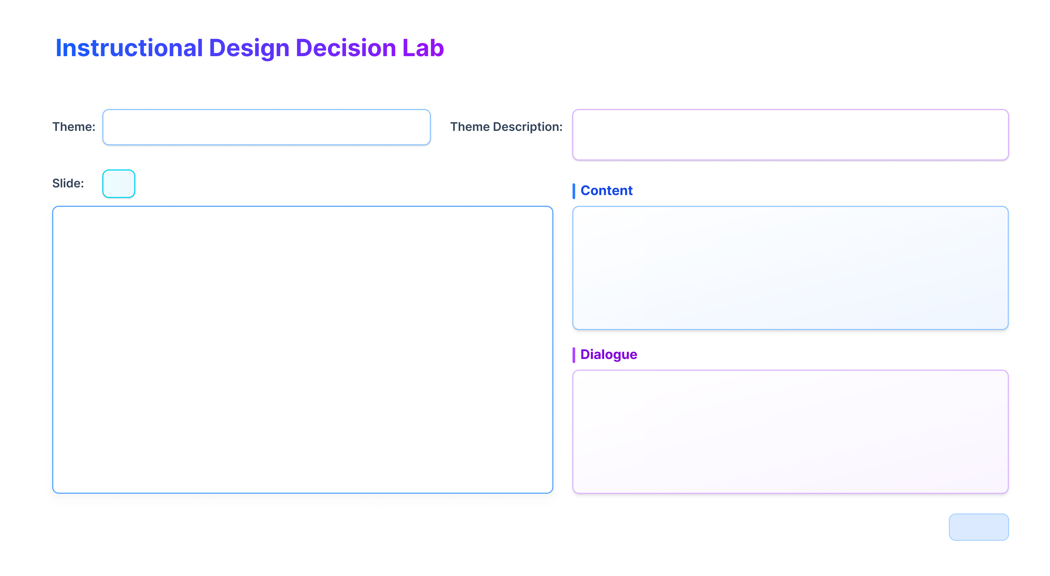
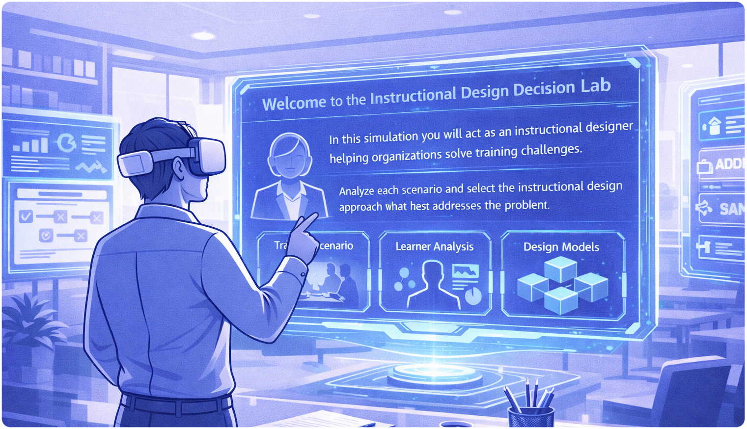
Storyboard • VR Learning Simulation • 10 Frames
Introduction to the Instructional Design Decision Lab
Learners enter a virtual consulting environment and assume the role of an instructional designer solving training challenges.
#1
The VR simulation begins inside a digital consulting workspace designed to resemble a professional instructional design environment. A holographic dashboard introduces the learner to the simulation and explains the task. Learners analyze real-world training scenarios and determine which instructional design approach best fits the situation based on contextual constraints such as learner characteristics, project timelines, and delivery methods.
System Voice:
Welcome to the Instructional Design Decision Lab.
In this simulation you will act as an instructional designer helping organizations solve training challenges. Analyze each scenario and select the instructional design approach that best addresses the problem.
Page 1

Slide 2
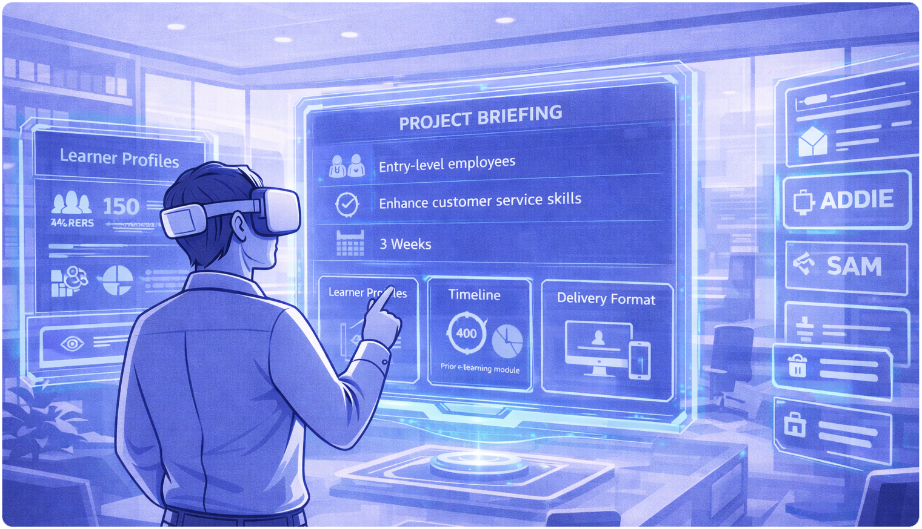
Virtual Consulting Workspace
The learner explores the simulated consulting environment to review project information.
#2
The learner enters a virtual consulting office containing interactive scenario dashboards, project briefing panels, and instructional design resources. Information panels display details about the training project including learner characteristics, project timelines, delivery format, and accessibility requirements. Learners navigate the workspace to collect the information needed to evaluate the instructional design challenge.
AI Assistant:
You are now entering the consulting workspace. Review the project briefing carefully before making your instructional design decision.
Page 2

Slide 3
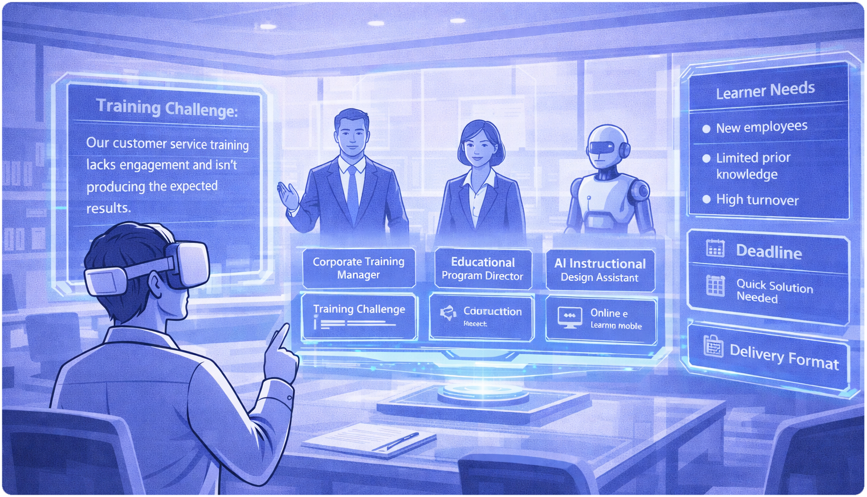
Stakeholder Briefing
Virtual stakeholders introduce the training challenge and provide contextual information.
#3
Learners interact with digital stakeholders representing individuals typically involved in instructional design projects. These include a corporate training manager, an educational program director, and an AI instructional design assistant. Each stakeholder explains the goals of the training program and describes organizational constraints that must be considered when designing the instructional solution.
Corporate Training Manager:
Our company is launching a new enterprise software system next month. Employees need training to learn how to use the platform before the system goes live.
Page 3

Slide 4
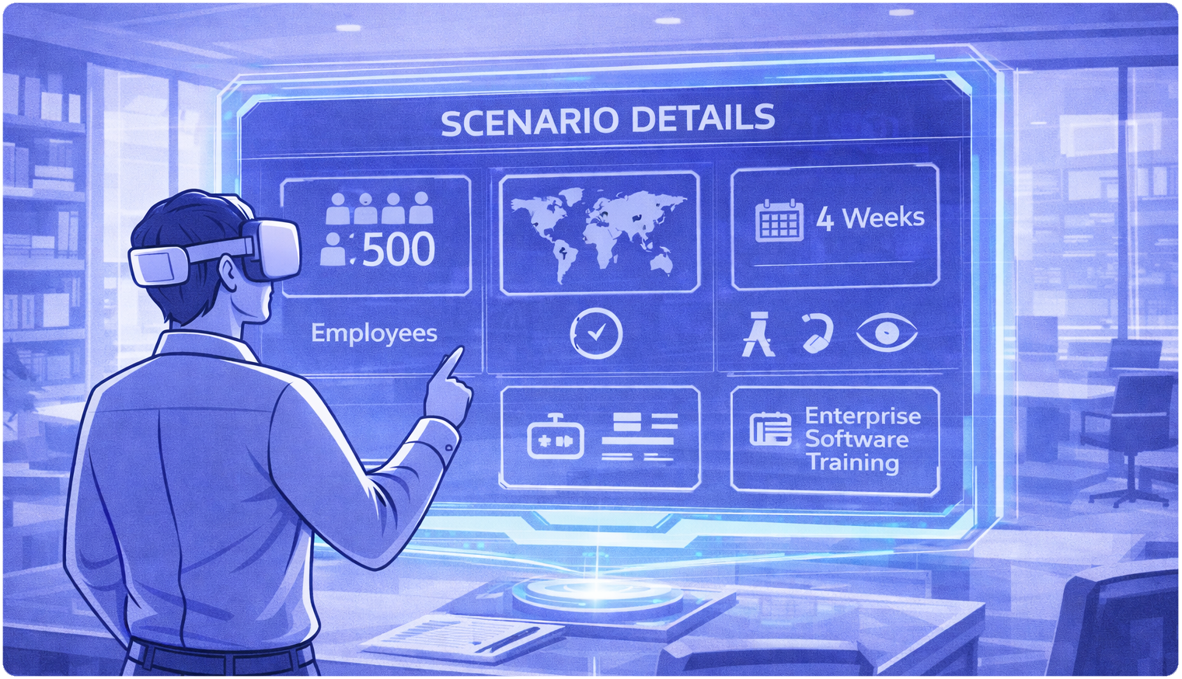
Training Scenario Analysis
The learner reviews the instructional design problem and identifies key constraints.
#4
The scenario describes a technology company that must train more than 500 employees on a newly implemented enterprise software system. The training must be delivered within four weeks and must accommodate employees with different levels of technical experience. The workforce is geographically distributed requiring remote training delivery and accessible learning materials. Learners analyze these variables before deciding on an instructional design approach.
Stakeholder Avatar:
We need a training program that prepares employees to use the system efficiently before launch day. The solution must work for both experienced and inexperienced users.
Page 4

Slide 5
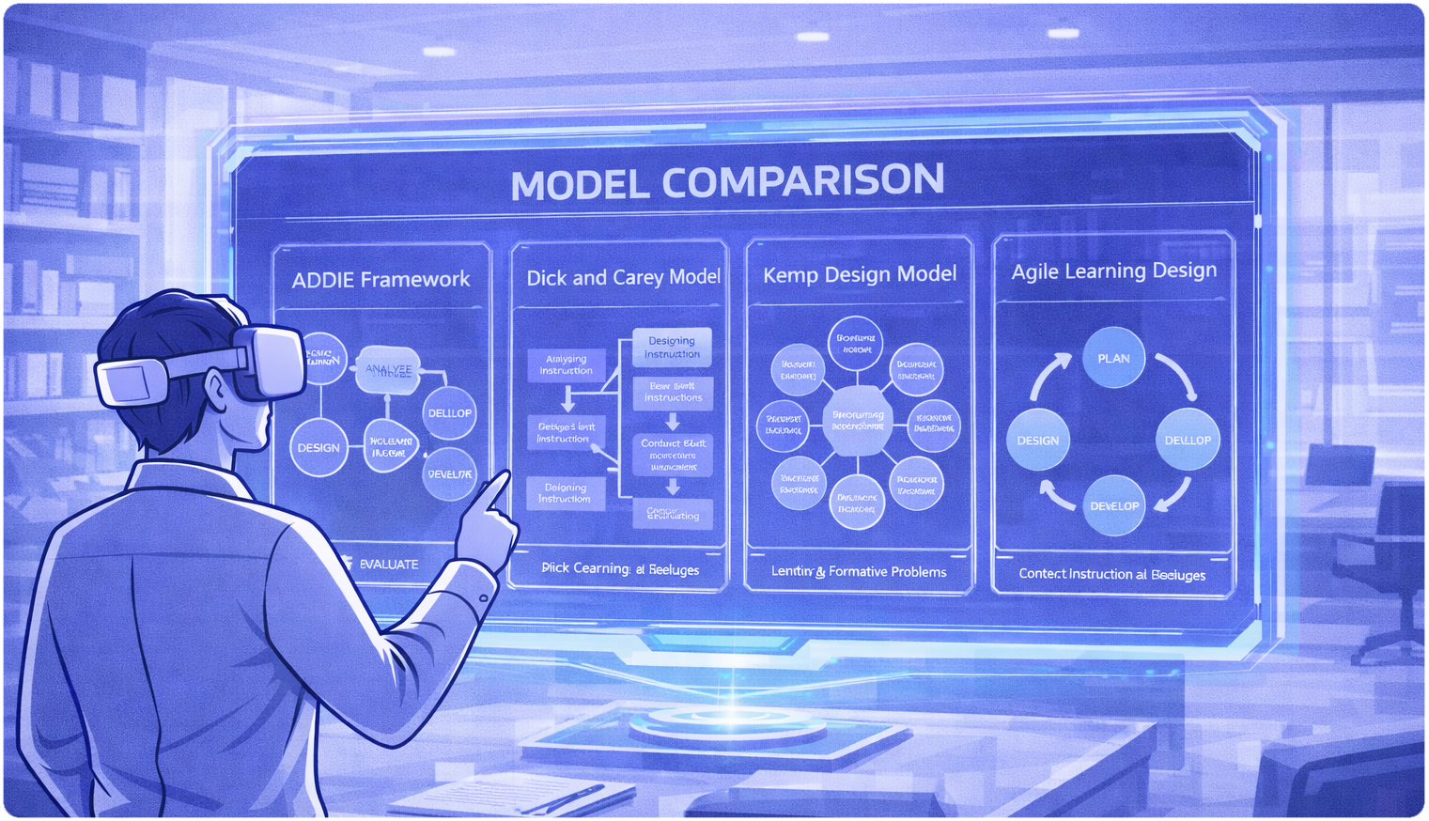
Instructional Design Options
Learners review different instructional design approaches that could be used to develop the training program.
#5
The Instructional Design Decision Lab simulation presents instructional design approaches including the ADDIE framework, the Dick and Carey model, the Kemp instructional design model, and Agile Learning Design. Each approach includes a brief overview describing its design process and typical applications. Learners explore the strengths and limitations of each approach and consider how the approaches align with the scenario constraints.
AI Assistant:
Different instructional design approaches provide different development strategies. Review each option carefully and consider how it supports the project requirements.
Page 5

Slide 6
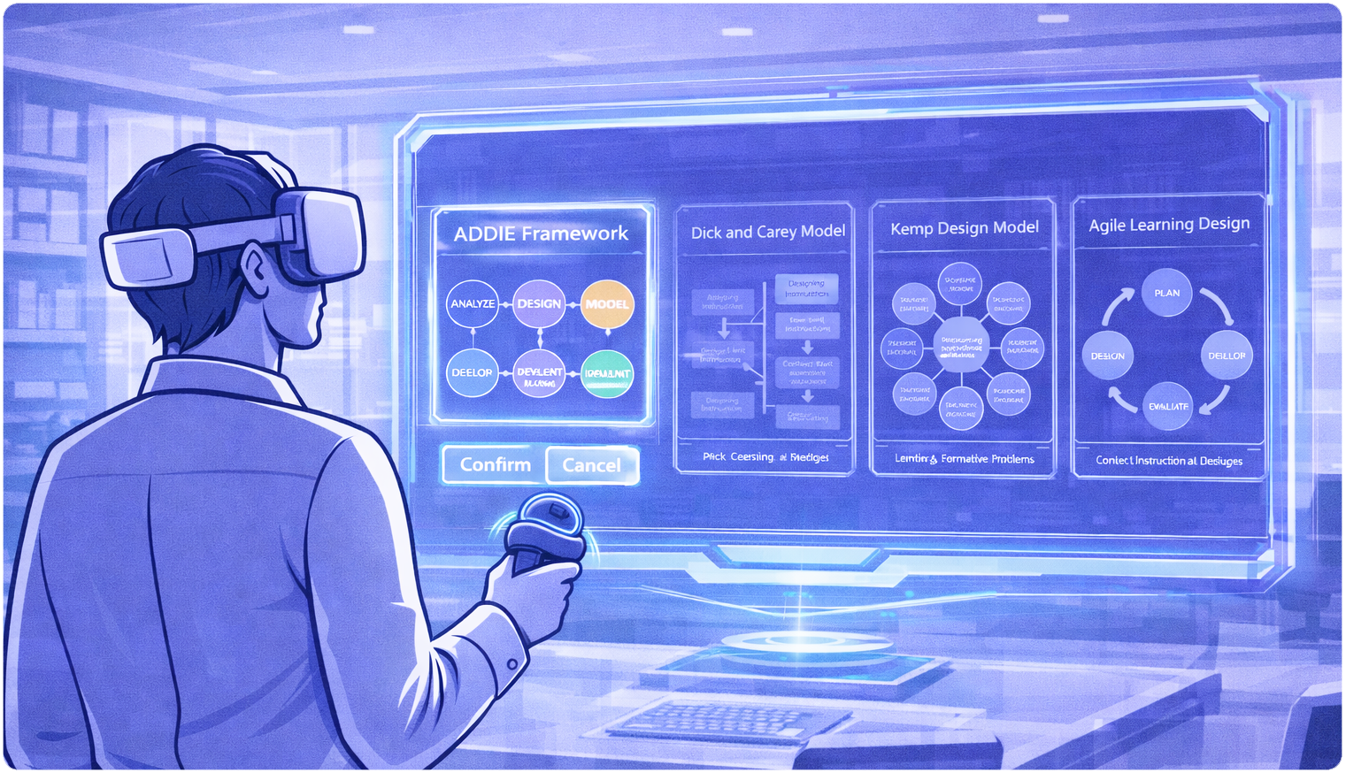
Instructional Design Decision
The learner selects the instructional design approach that best fits the scenario.
#6
After analyzing the scenario and reviewing the design approaches, the learner selects the instructional design approach that best addresses the training challenge. The learner also provides a short explanation describing why the selected approach is appropriate based on project constraints, learner needs and delivery requirements.
AI Assistant:
Please select the instructional design approach that best fits this scenario and explain the reasoning behind your decision.
Page 6

Slide 7
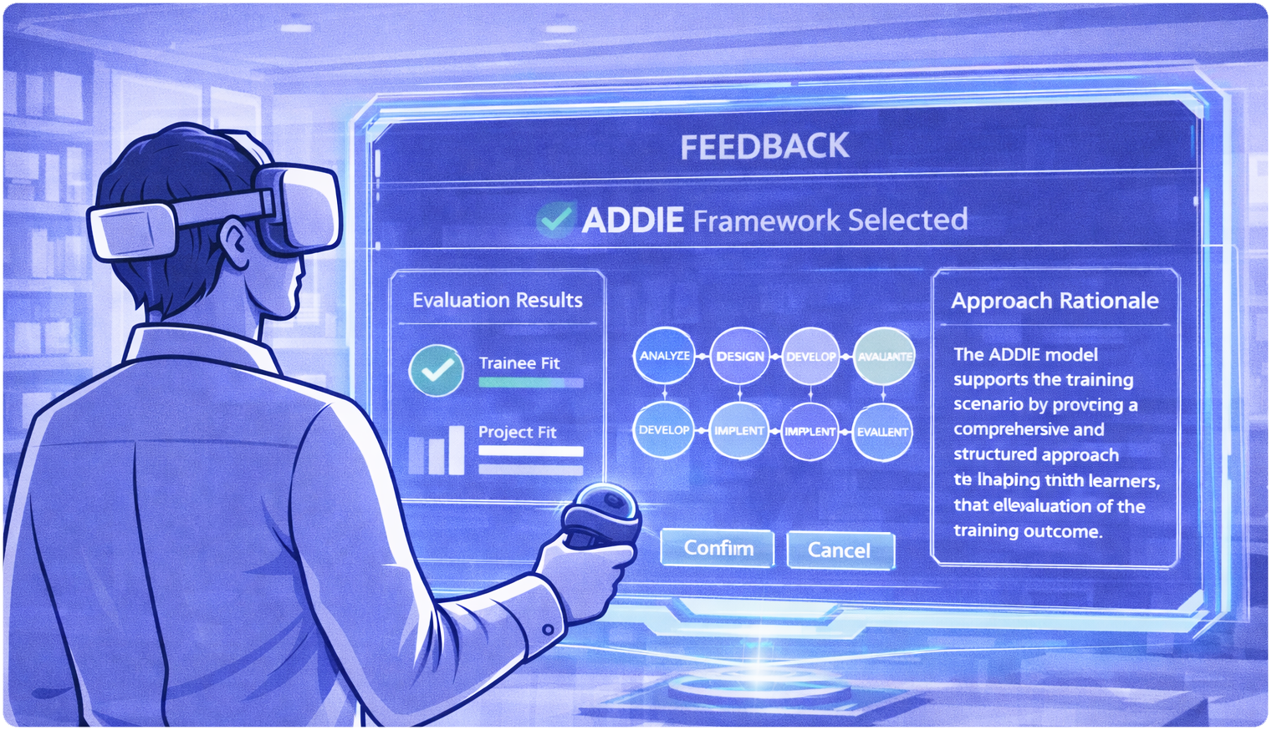
Simulation Feedback
The system evaluates the learner decision and provides instructional feedback.
#7
The VR system analyzes the learner’s selected instructional design approach and provides immediate feedback explaining how the selected approach aligns with the project requirements. If the learner chooses an effective instructional design approach, the system confirms the reasoning and explains how the selected approach supports the training objectives. If the learner selects a less effective approach the system explains the limitations and allows the learner to reconsider the decision.
AI Assistant:
Your decision demonstrates strong consideration of the project timeline and learner needs. Agile Learning Design works well in this scenario because it supports rapid development and iterative improvement.
Page 7

Slide 8
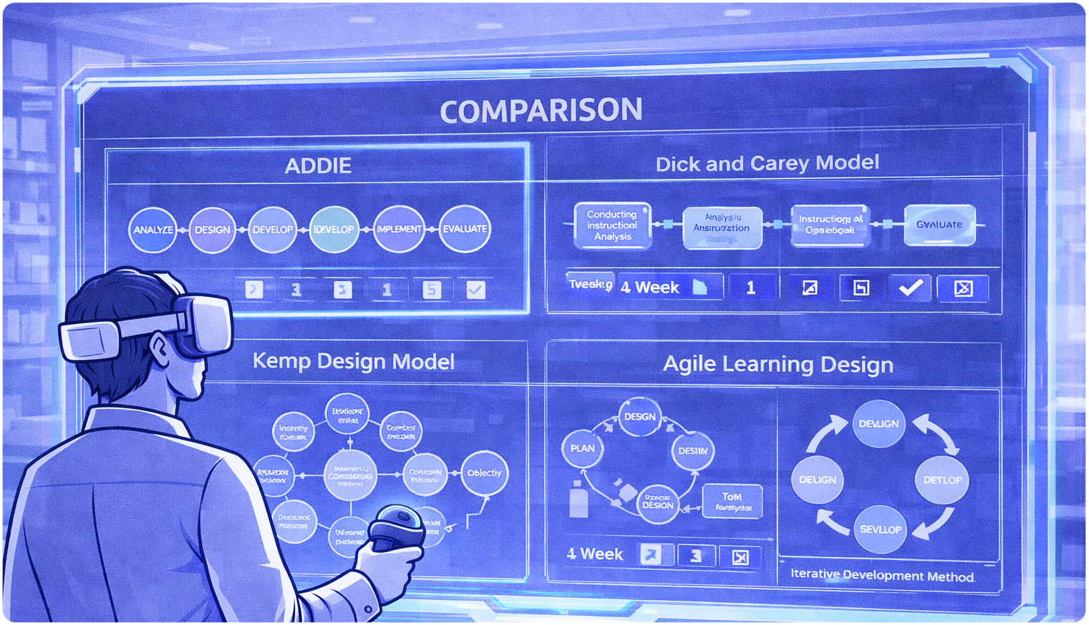
Reflection and Comparison
Learners compare their decision with alternative instructional design approaches.
#8
The simulation presents alternative design approaches and demonstrates how different instructional design approaches influence the training development process. Learners review how the project timeline development strategy and instructional methods may change depending on the approach selected.
AI Assistant:
Instructional design decisions depend on context. Comparing multiple approaches helps designers determine the most effective strategy for each situation.
Page 8

Slide 9
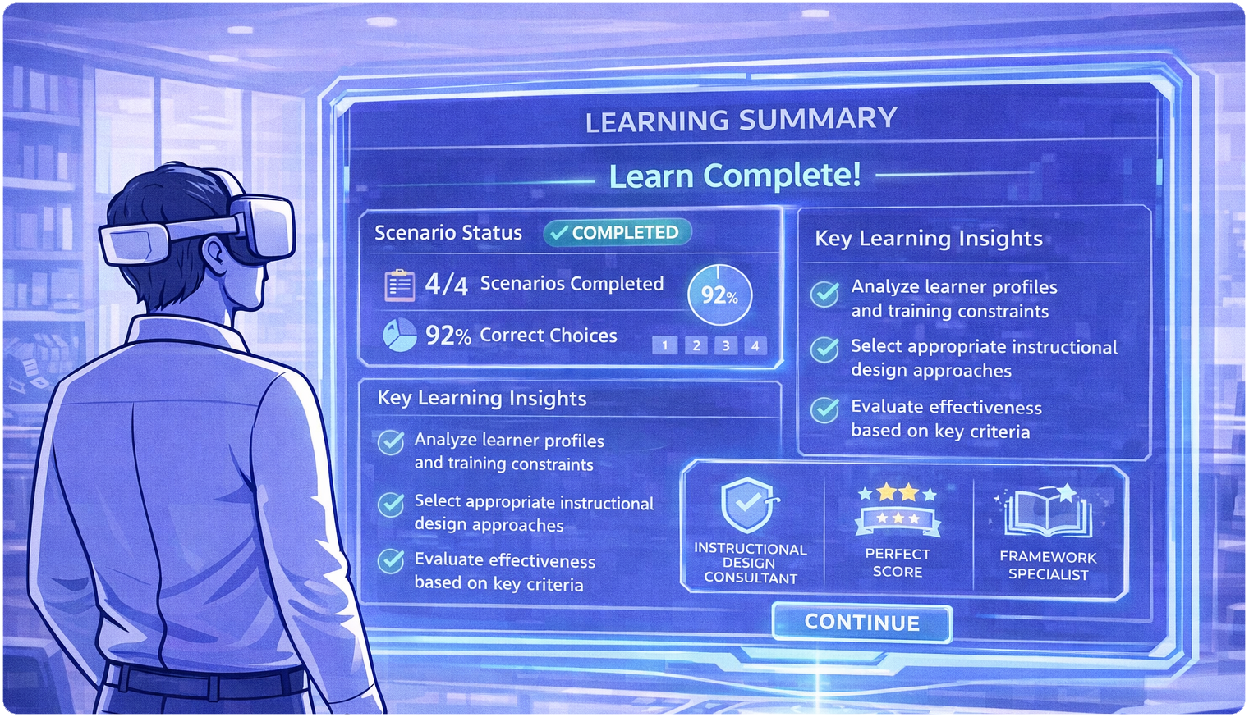
Learning Summary
The simulation summarizes the learner progress and reinforces key instructional design principles.
#9
The VR simulation concludes with a summary of the learner decision making process. Key concepts highlighted include the importance of analyzing learner needs, evaluating project constraints, and selecting instructional design approaches aligned with organizational goals. Learners are encouraged to continue practicing with additional scenarios to strengthen their instructional design expertise.
AI Assistant:
You have successfully completed this instructional design challenge. Continue exploring additional scenarios to further strengthen your instructional design expertise.
Page 9

Slide 10

References
Research supporting the use of immersive virtual reality in learning environments.
#10
Jensen, L., & Konradsen, F. (2018). A review of the use of virtual reality head-mounted displays in education and training.
Makransky, G., & Petersen, G. B. (2019). Immersive virtual reality and learning: A meta-analysis.
Parong, J., & Mayer, R. E. (2021). Learning science in immersive virtual reality.
Radianti, J., Majchrzak, T. A., Fromm, J., & Wohlgenannt, I. (2020). A systematic review of immersive virtual reality applications for higher education.
Research supporting the instructional value of immersive virtual reality learning environments.
Page 10

